Slide 1










“Pull up in the monster, automobile gangsta. With a bad bitch that came from Sri Lanka”
TOP SONGS
2023 MOST STREAMED SPOTIFY SONGS
Notes:
Order: Roshni (Introduction)
Javeria
Mike
JinCheng
Roshni
Tiffany

Slide 2




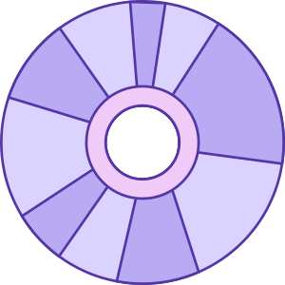



Our Task
Look at the different characteristics of the most streamed songs
Purpose: Understand the trends and correlations that are shared between popular songs
Applications: Help artists orient their music, allow investors to decide what to spend their money on, track performance of songs
Importance: Analysis of this data can be used for projection of future performance and predict trends

Slide 3
Our Data
Information: Most Streamed Spotify Songs 2023
Format: Data Table, CSV File
Where: Kaggle
Content: Attributes include track_name, artist_name, artist_count, released_year, released_month, released_day, in_spotify_playlists, in_spotify_charts, streams, in_apple_playlists, in_apple_charts, bpm, key, mode, danceability_%, energy_%, acousticness_%, instrumentalness_%, liveness_%, speechiness_%, and more
Representation: used pandas and matplotlib to represent data
Process: import CSV file into pycharm/google colab, improve readability of code, perform cleanup of unnecessary data (some columns were string literals which need to be casted into ints)
Information: this representation causes attributes that are defined as strings to be lost because information is converted into ints, all numeric information is preserved

Slide 4
Preprocessing
Import CSV file into Pycharm/ Google Colab
Filter data table to only look at specific attributes being examined (danceability, energy, lyrics, months released, acoustics, instrumentals
Plot data based on remaining attributes
These steps help narrow down the data and allow for interpretation by sorting through the extensive data table

Slide 5
Modeling
We used cluster models, bar charts, scatter plots, and histograms for visualization of data
The input was the numerical values that we filtered from the data table and the output was the tables and analysis that we found. We chose this model for easy interpretation of data.
Evaluated model by looking at specific characteristics of songs like danceability, lyrics, energy, acoustics, instrumentals, and released months
Our model performed well for some parts because relationships were found which were then used in analysis
Limitations include that certain attributes that were compared showed no correlations so they would not be helpful in analysis, the data was only partially analyzed so many characteristics were not represented, in terms of lyrics only certain words could be analyzed and not whole phrases which limits the data that we looked at

Slide 6
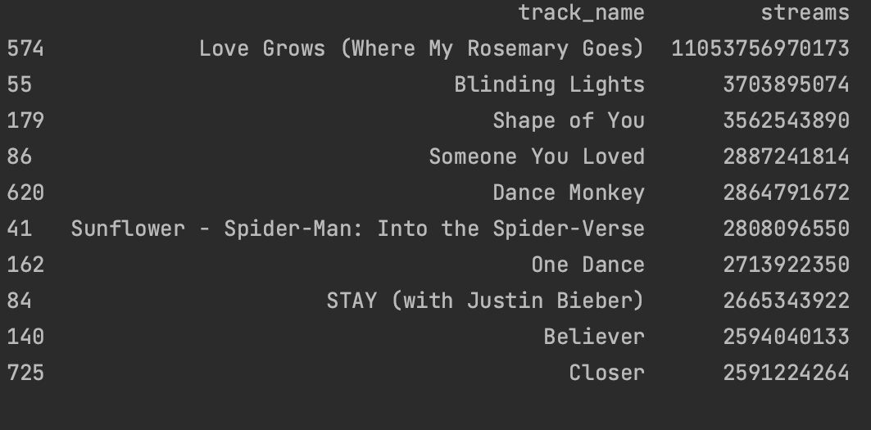
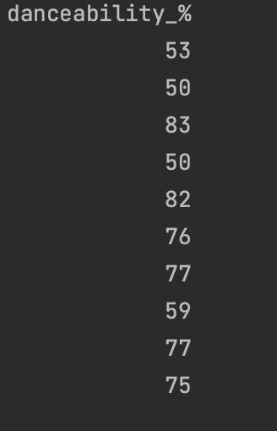
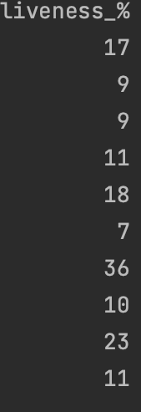


track_name: Name of the song
streams: Total number of streams on Spotify
danceability_%: Percentage indicating how suitable the song is for dancing
liveness_%: Presence of live performance elements

Slide 7
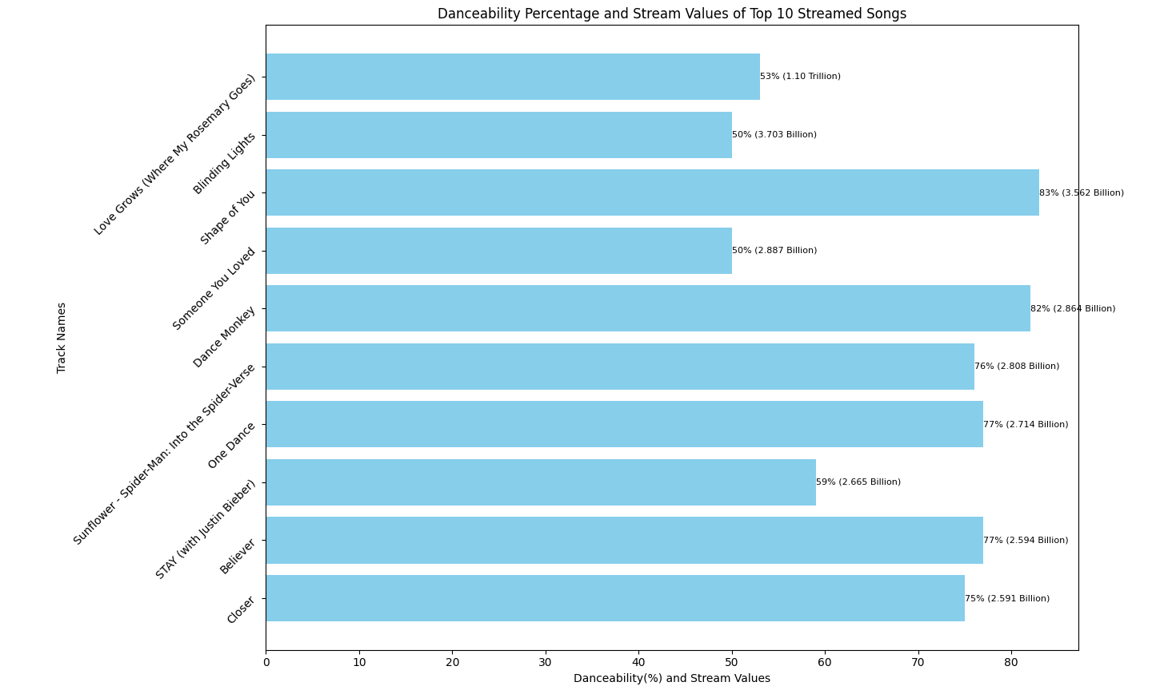
Danceability and liveliness of top 10 streamed songs
The track with the most views holds a danceability score of 53%
"Shape of You" is the song with the highest danceability score of 83% among the top three songs, followed closely by "Dance Monkey” as the top 5 song with 82% dancibilty score.
Analysis:
The top 1 song, possess a different mood, is a sadder song while “Dance Monkey” and “Shape of You” are upbeat and catchy contributing to their higher dancibilty score.
This correlation suggests that songs with more lively, energetic, elements tend to have higher danceability scores, reflecting their ability to engage listeners and inspire movement in dance.

Slide 8
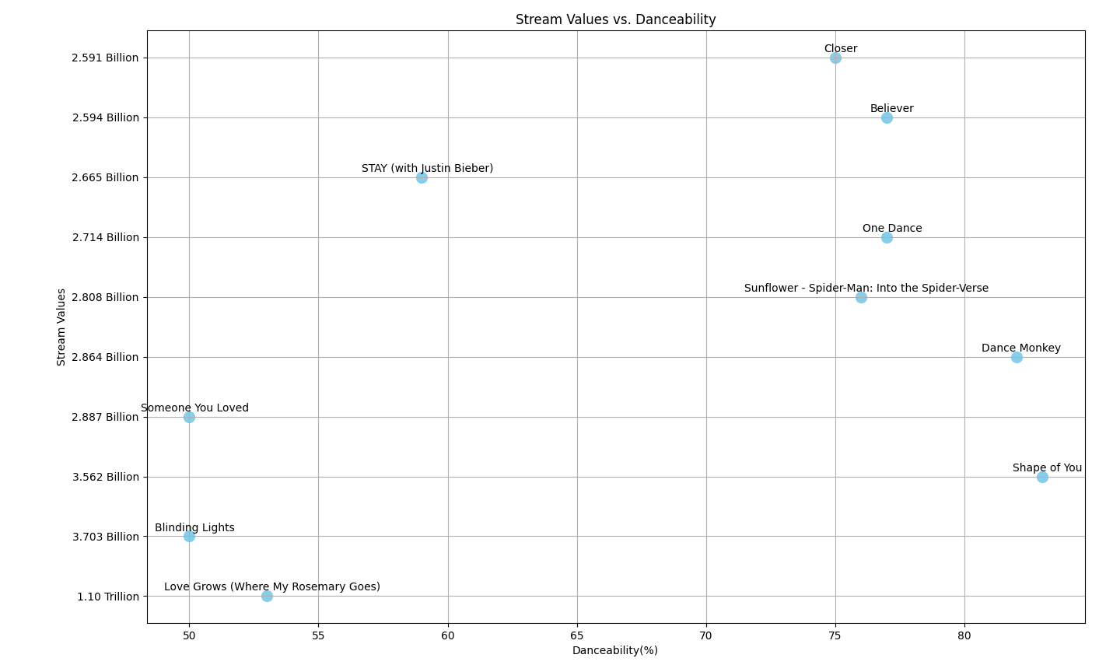
Danceability and liveliness of top 10 streamed songs
Scatterplot provides a more concise visualization compared to the histogram
Allows for easier understanding

Slide 9
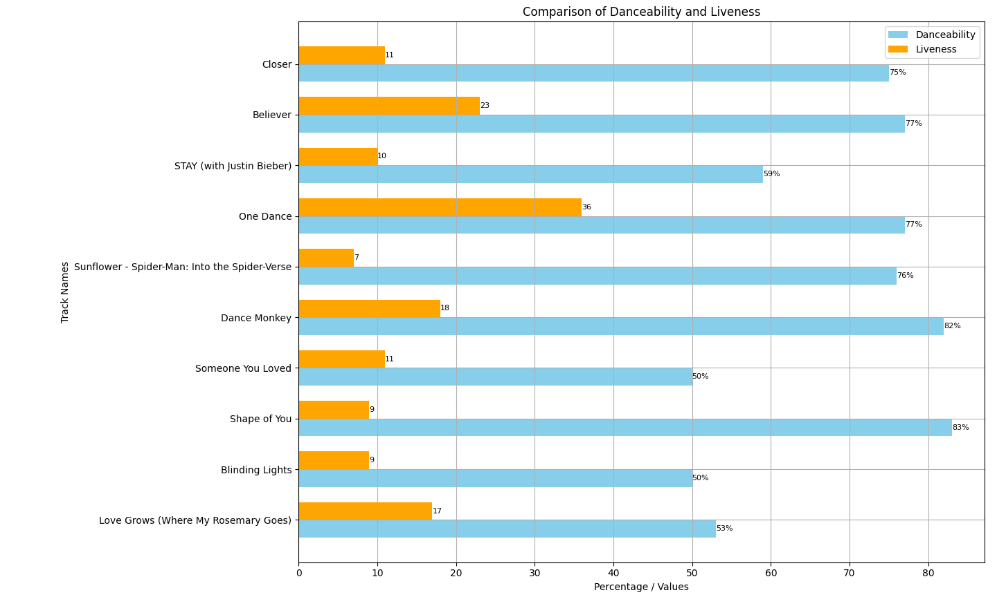
Danceability and liveliness of top 10 streamed songs
One Dance (top 7) has the high liveliness at 36 and danceability score of 77%
Sunflower- Spider-Man in the Spider-Verse (top 9) has lowest liveness performance at 7 and danceability score of 76%

Slide 10
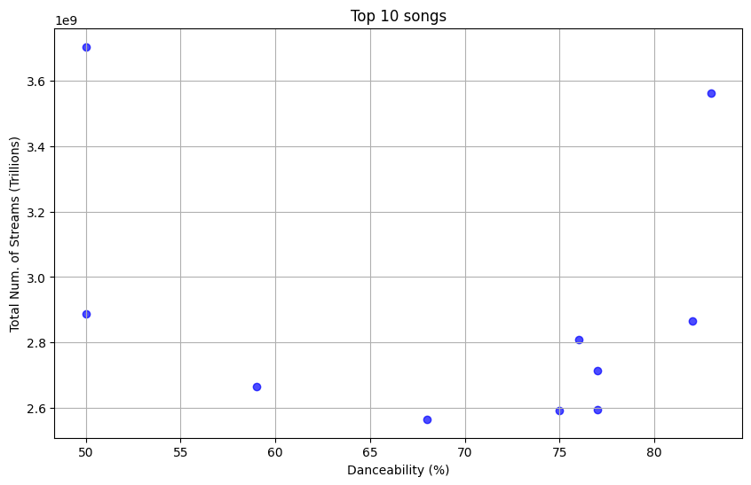
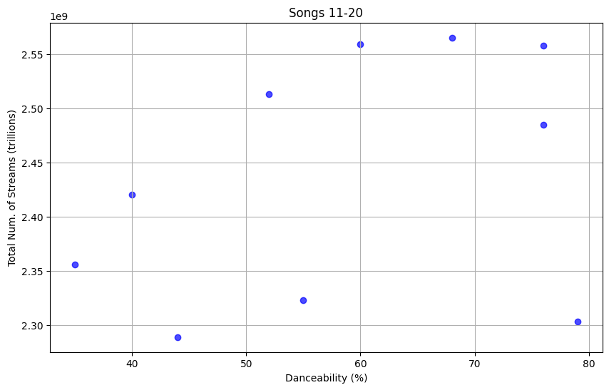
Danceability of top 10 vs subsequent 11-20 ranked songs
Average Danceability for songs in Top 10 = 68.2%
Average Danceability for songs in 11-20 = 51.7%
Difference of 16.5%!
Analysis: Top 10 Songs have higher danceability

Slide 11
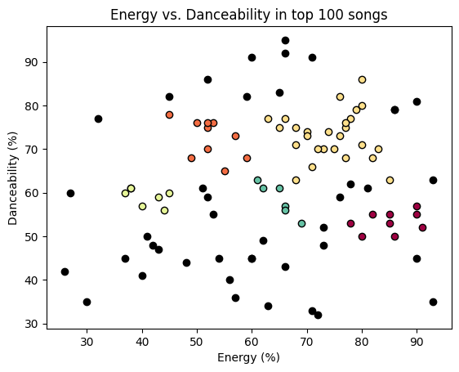
Energy and Danceability of Top 100 songs
X-axis: Energy level
Y-axis: Danceability level
DBSCAN(eps = 6)
5 clusters (colored)
42 noise points (black)
No obvious correlation found between the energy level and danceability level in top 100 songs

Slide 12
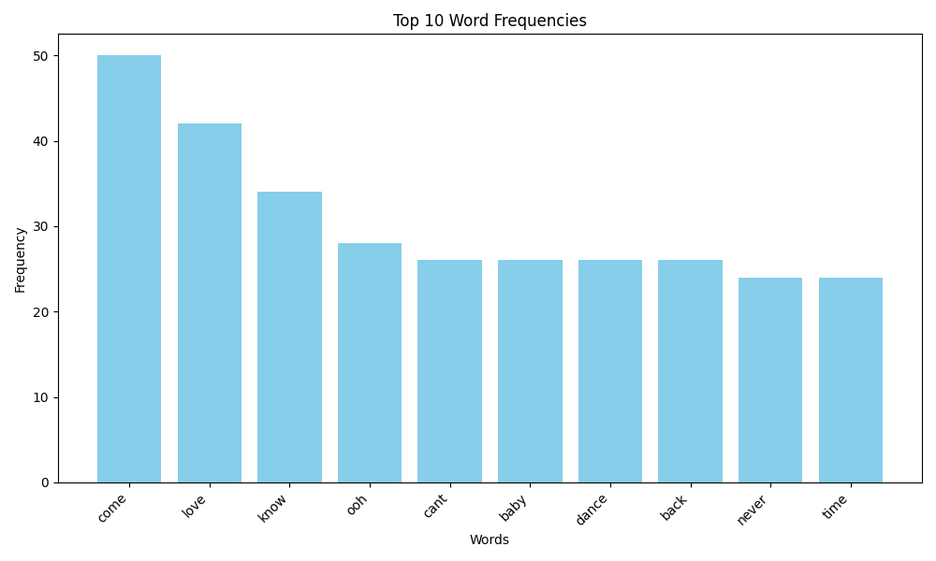
Top 10 Words Used in Top 10 Songs
Created a separate CS file for the lyrics of the top ten songs
Created a python dictionary of the words used in each of those songs and removed unnecessary words that don’t have meaning and got this list
“Come” and “Love” appear the most frequently

Slide 13
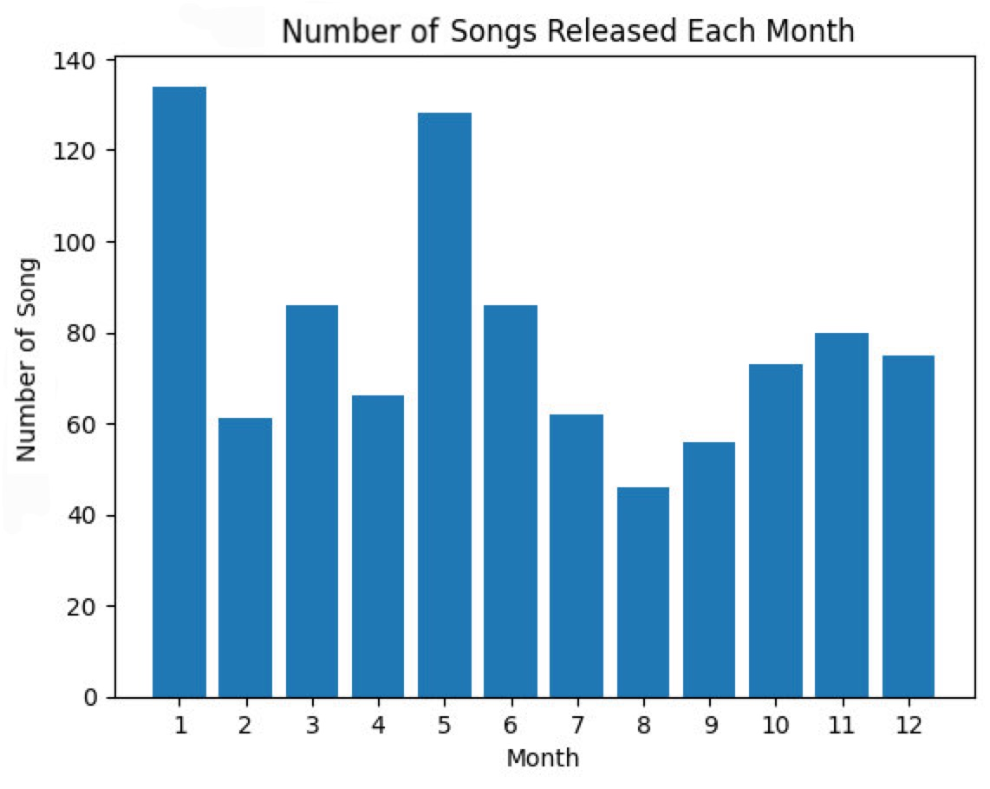
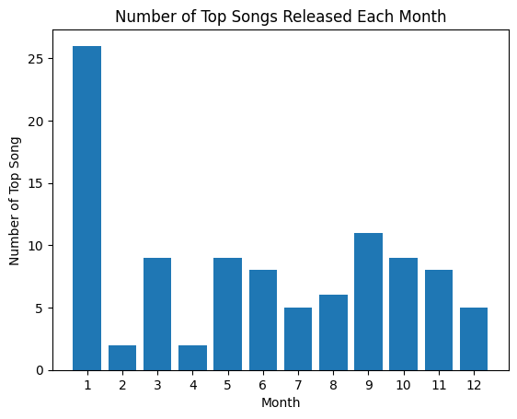
Released Months of Top Streamed Songs
Distribution of what month produces most released songs
Total of 953 songs in dataset
14.06% released in January, closely followed by May with 13.43%
Analysis: Most songs are released in January and the most streamed 100 songs are also released the most in January.
People like producing music during the new year – everything resets
May is beginning of summer so the change of seasons may lead to more new music
Can be used to decide when to release music for better chance of more streams, less competition, which seasons people like to listen to music more
Distribution of what month produces most released songs out of the top 100
100 top streamed songs from dataset
26% released in January, a lot higher than any of the other months

Slide 14
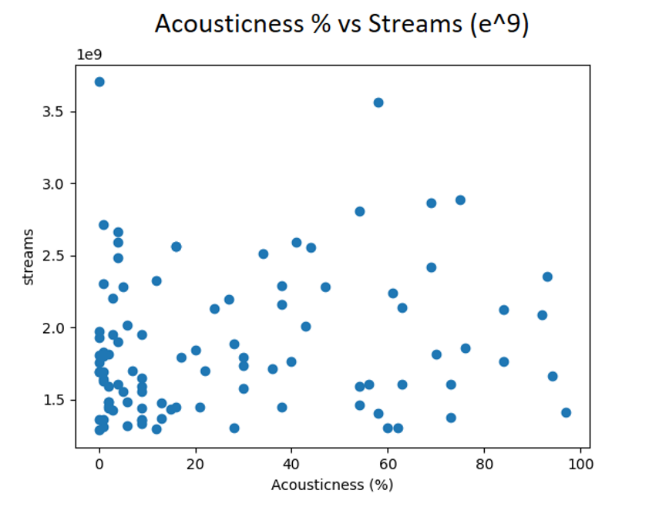
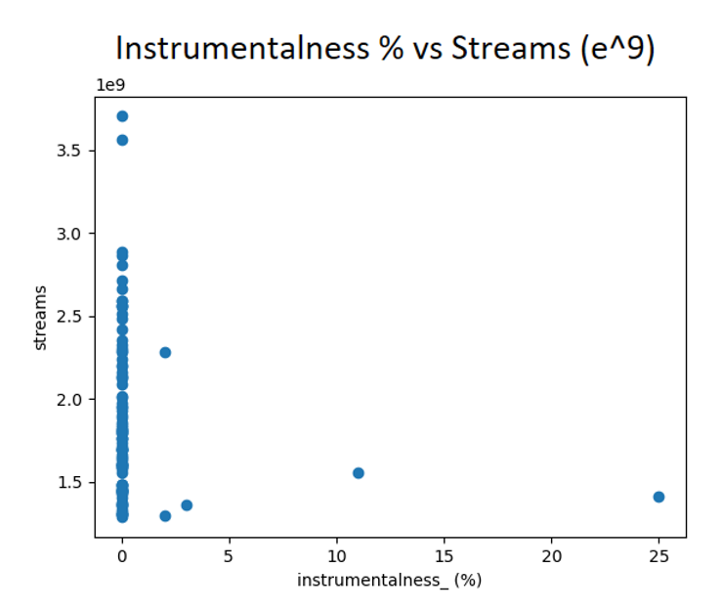
Instrumentals and Acoustics of Songs
Distribution of top 100 songs versus how acoustic they are
Slight corelation between accousticness and how well a song performs- less acoustic, more streams
Analysis:
Correlation between low instrumentals and higher streams
Slight correlation between low acoustics and higher streams
Distribution of top 100 songs versus how instrumental they are
Correlation between 0% instumentalness and how well the song performs

Slide 15
Key Takeaways + Conclusions
Top 10 streamed songs aren’t even from 2023 (songs were released in 2017 and 2018) – people are stuck in the past
People like to dance! Danceability matters!
Perceived energy level has no matter with danceability
January is a popular month for releasing songs and produces a lot of top streamed songs
Acoustics and instrumentals have no correlation

Slide 16
Citations
Slides Accessed on Canvas, Basic Format
Wood, A. (2023). 2023 Most Streamed Spotify Songs [PowerPoint slides]. PCC Canvas.
https://canvas.com
Most streamed Spotify Songs 2023. (2023, August 26). Kaggle.
https://www.kaggle.com/datasets/nelgiriyewithana/top-spotify-songs-2023

